Slide 1

Predicting Customer Buying Behaviour
Precious Victor

Slide 2

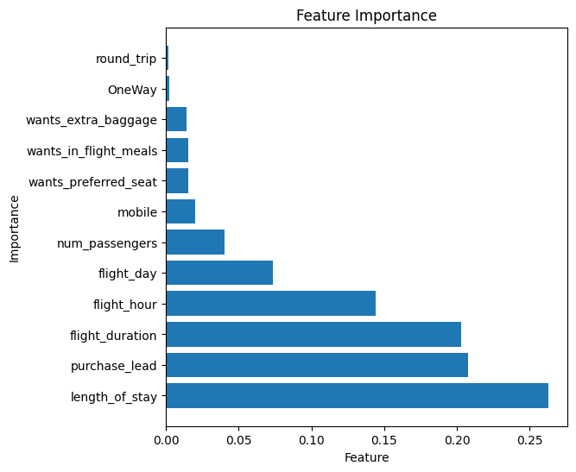
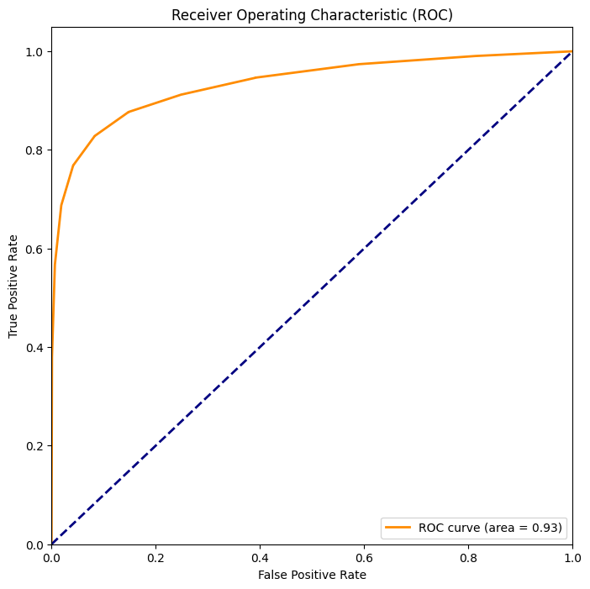
Project Insight
In this project, we aimed to develop a predictive model to predict customer buying behaviour. To achieve this, we explored various machine learning algorithms, feature engineering, hyperparameter tuning and cross-validation. Our final model, Random Forest Classifier demonstrated as follows:
Accuracy score: 0.87
Precision score: 0.91
Recall score: 0.83
F1 score: 0.87
ROC area: 0.93
Notes:
Notes to presenter:
Description of what you learned in your own words on one side.
Include information about the topic
Details about the topic will also be helpful here.
Tell the story of your learning experience. Just like a story there should always be a beginning, middle and an end.
On the other side, you can add a graphic that provides evidence of what you learned.
Feel free to use more than one slide to reflect upon your process. It also helps to add some video of your process.

